Slide 1
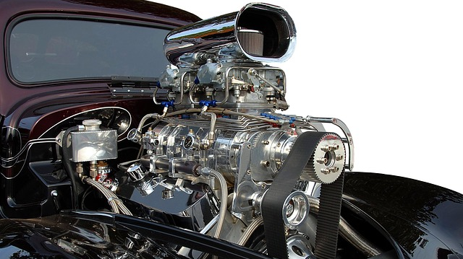
Contoso Mechanics Ltd.
Because so much riding on your tires

